Slide 1
Investing in Health Systems: Insights into how Current Health Financing Allocations Shape UHC Service Coverage and Key Health Outcomes

Slide 2
Background
Health financing is central to achieving 100% Universal Health Service Coverage (UHC).
WHO standards emphasize raising sufficient funds, pooling risks fairly, and purchasing services strategically to ensure people have access to quality care without financial hardship.
Most countries in Africa face challenges such as high out-of-pocket (OOP) spending, fragmented risk pools, underfunding of public health, and overreliance on donor funding.
In this section, we aim to identify the optimal ratios of government (GGHED), donor (EXT), and private (PVTD) expenditure to current health expenditure (CHE) that:
Maximize Universal Health Service Coverage (UHC)
Maximize life expectancy (LE)
Minimize maternal mortality ratio (MMR)
Minimize infant mortality ratio (IMR)
Because after all, “Health financing is not just about spending more, but spending better and pooling risks fairly”.

Slide 3
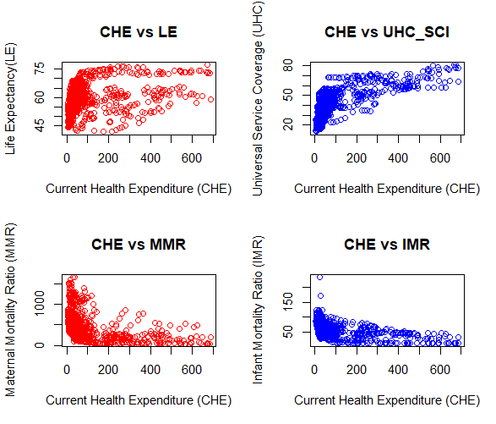
Relationship between CHE and UHC_SCI and Key Health Outcomes
A scatter plot of data from 47 WHO African regional countries spanning from 2000 to 2024 was done to check the relationship between current health expenditure (CHE) and key health outcomes such as life expectancy (LE), maternal mortality ratio (MMR) per 100,000 live births, infant mortality ratio (IMR) per 1,000 live births and universal service health coverage (UHC_SCI).
Figure 1: Relationship between CHE and Key Health Outcomes
Figure 1 shows that life expectancy (LE) and universal health coverage index (UHC_SCI) non-linearly increase with an increase in current health expenditure, the maternal mortality ratio (MMR) per 100,000 live births, and the infant mortality ratio (IMR) per 1,000 live births, respectively (nonlinearly) decrease with an increase in CHE.

Slide 4
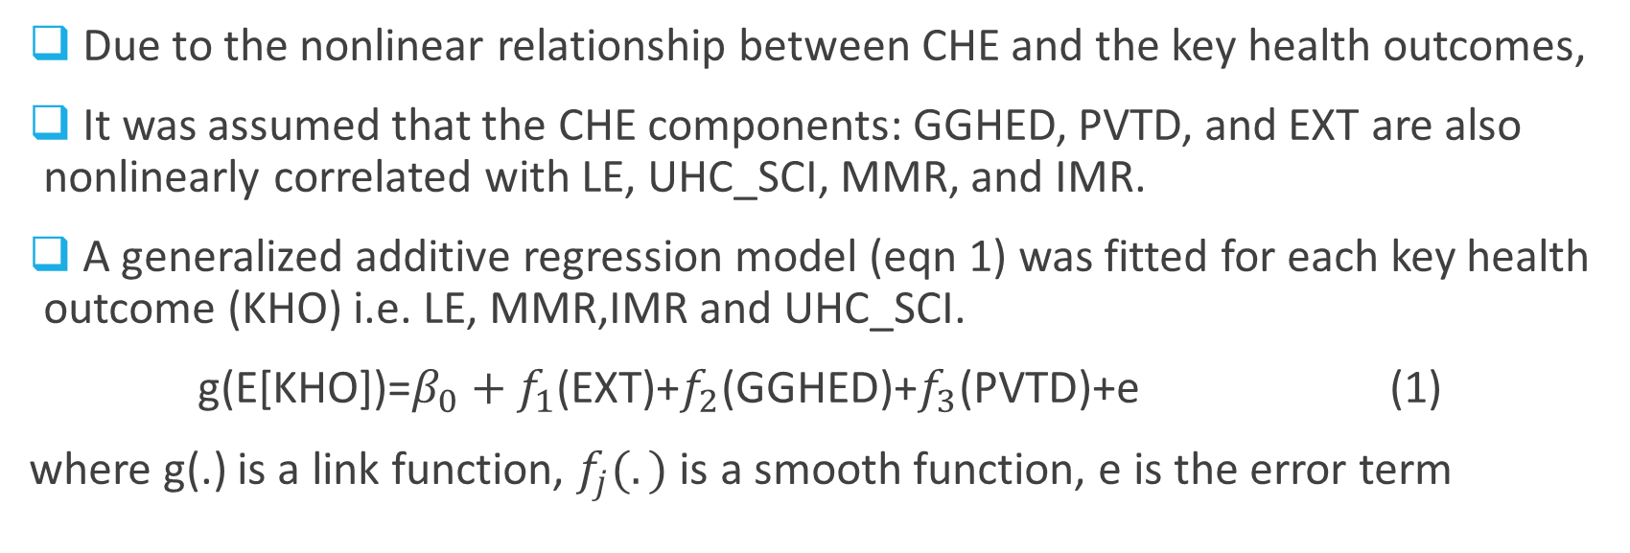
Effect of CHE components on Key Health Outcomes and Service Coverage Index
Due to the nonlinear relationship between CHE and the key health outcomes,
It was assumed that the CHE components: GGHED, PVTD, and EXT are also nonlinearly correlated with LE, UHC_SCI, MMR, and IMR.
A generalized additive regression model (eqn 1) was fitted for each key health outcome (KHO) i.e. LE, MMR,IMR and UHC_SCI.
g(E[KHO])=$β_{0}+f_{1}$(EXT)+$f_{2}$(GGHED)+$f_{3}$(PVTD)+e (1)
where g(.) is a link function, $f_{j}(.)$ is a smooth function, e is the error term

Slide 5
Effect of CHE components on Key Health Outcomes and Service Coverage Index contd…
The results of the GAM model were as summarized in Table 1.
Table 1 results show that, on average, government health funding (GGHED) has the most significant effect, followed by external donor funding (EXT), then private funding (PVTD) in explaining all the key health variables.
Table 1: Fitted GAM Results
Key Health Variable | EXT | GGHED | PVTD | Deviance Explained (%)
Life Expectancy (LE) | 6.447*** | 7.975*** | 5.440*** | 30.2
Maternal Mortality Ratio (IMR) | 3.839*** | 8.692*** | 8.130*** | 40.3
Infant Mortality Rate (IMR) | 5.363*** | 8.565*** | 3.620*** | 42.2
Universal Health Coverage (UHC_SCI) | 1.928 | 2.803** | 1.000 | 64.5
Sig. codes: ***<0.001, **<0.01, *<0.05

Slide 6
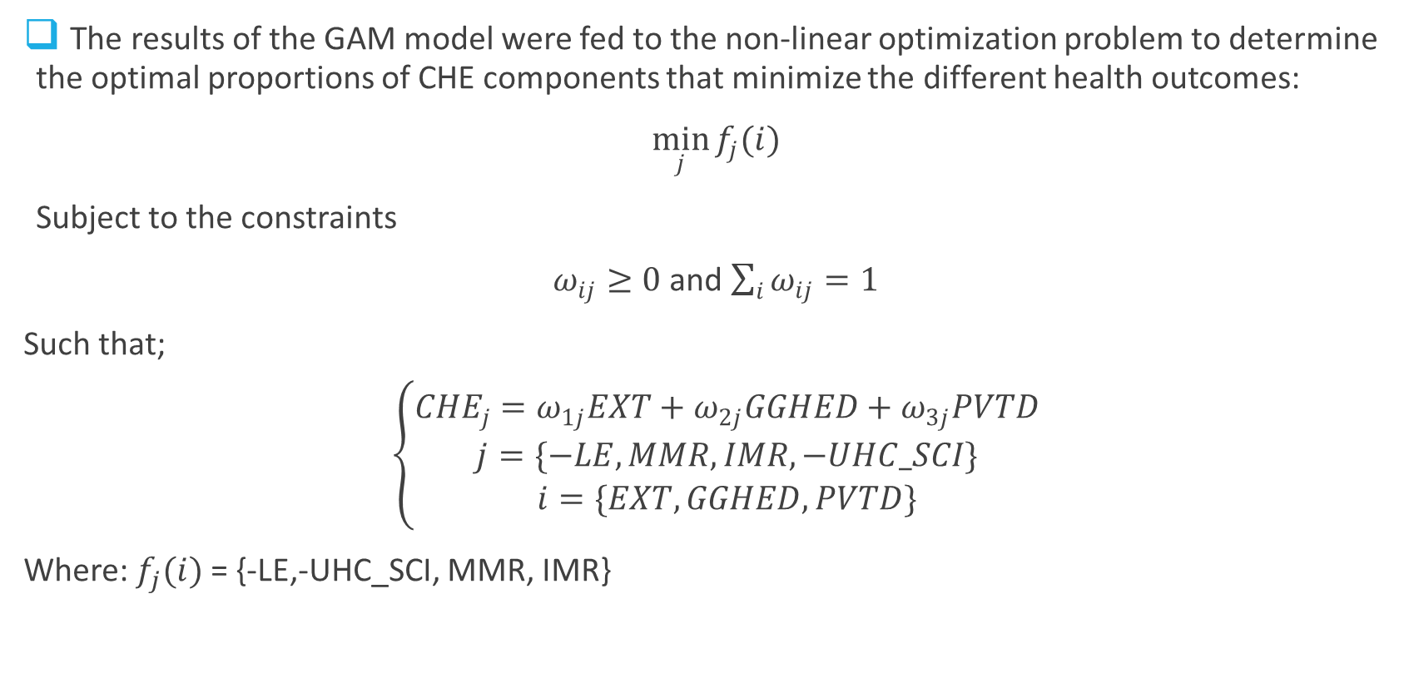
Optimal Allocation of CHE Components
The results of the GAM model were fed to the non-linear optimization problem to determine the optimal proportions of CHE components that minimize the different health outcomes:
$\min_{j}{f_{j}(i)}$
Subject to the constraints
$ω_{ij}≥0$ and $\sum_{i}{ω_{ij}}=1$
Such that;
$\left\{\begin{aligned}{CHE}_{j}=ω_{1j}EXT+ω_{2j}GGHED+ω_{3j}PVTD \\ j=\{−LE, MMR, IMR, −UHC_SCI\} \\ i=\{EXT, GGHED, PVTD\}\end{aligned}\right.$
Where: $f_{j}(i)$= {-LE,-UHC_SCI, MMR, IMR}

Slide 7
Optimal Allocation of CHE Components contd…
Table 2 below show the optimal allocation of CHE funding that improves the different health outcomes.
It can be seen that to obtain great health outcomes, governments should be encouraged to contribute 67% of CHE, followed by the private sector funding (contribute 19% of CHE), and the remaining 14% of CHE to be funded by external donor funding.
Table 2: Optimal Current Health Expenditure (CHE) Allocation Proportions (%)
Key Health Variable (j) | EXT (i=1) | GGHED (i=2) | PVTD (i=3)
Life Expectancy (LE) | 13.76 | 50.05 | 36.19
Maternal Mortality Ratio (MMR) | 7.71 | 92.29 | 0.00
Infant Mortality Rate (IMR) | 16.68 | 43.95 | 39.37
Universal Health Coverage (UHC_SCI) | 17.98 | 82.02 | 0.00
Averages | 14.03 | 67.08 | 18.89

Slide 8
Effect of 67% Government Expenditure on Health
A descriptive analysis of the effect of investing more than 67% of CHE on the different key health outcomes was done and summarized in Table 3.
Table 3 results show that for governments investing in >67% of CHE, their:
Universal Health Service coverage index is higher by 26%.
Life expectancy is higher by 12.5 years.
Maternal mortality ratios decrease by 414.5 deaths per 100,000 live births
Infant Mortality ratios decrease by 34 deaths per 1,000 live births
Table 3: Impact of Government Health Expenditure on Health Outcomes
Key Health Variable | SCI_UHC | LE | MMR | IMR
GGHED<=67% of CHE | 39.3 | 59.3 | 496.0 | 58.0
GGHED>67% of CHE | 65.3 | 71.8 | 81.5 | 24.0

